Slide 1

RUNGTA COLLEGE OF DENTAL SCIENCES & RESEARCH
TITLE OF THE TOPIC- ENDODONTIC SURGERY
DEPARTMENT OF – CONSERVATIVE DENTISTRY AND ENDODONTICS

Slide 2
Specific learning Objectives
At the end of this presentation the learner is expected to know ;
Core areas* | Domain ** | Category #
Introduction | Cognitive | Must know
Method | Psychomotor | Must know
Armamentarium | Cognitive | Must know
*Subtopic of importance
** Cognitive, Psychomotor or Affective
# Must know , Nice to know & Desire to know
( Table to be prepared as per the above format )

Slide 3
TABLE OF CONTENTs
Definition
Indication
Contraindication
Classification
Anatomic consideration
Patient preparation
Surgical access
Haemostasis
Root end resection and preparation
Root end filling
Flap closure and suture
Postoperative complications

Slide 4
Local Anesthesia for Surgery
Infiltration of the surgical site with a local anesthetic containing 1:50,000 epinephrine is the technique of choice to obtain vasoconstriction and hemostasis
The local anesthetic is first slowly deposited in the buccal root apex area of the alveolar mucosa at the surgical site and extended two or three teeth on either side of the site. Usually palatal or lingual infiltration is also required, although this requires a much smaller amount of local anesthetic than the primary buccal infiltration.
Every effort must be made to ensure profound local anesthesia before surgery begins.
Usually a minimum of 10 to 20 minutes is required from the time of injection to the start of surgery to ensure both profound local anesthesia and adequate vasoconstriction for hemostasis.
The patient should be asked about the usual signs of soft-tissue anesthesia, and a sharp explorer can be used to test the surgical area for sensation.

Slide 5
A supplemental block injection may be useful for mandibular teeth and maxillary posterior teeth.
In the maxillary anterior area, a palatal approach to the anterior middle superior nerve may be helpful. The key to this approach is slow injection of approximately 1 ml of local anesthetic in the area of the first and second maxillary premolars, midway between the gingival crest and the palatal midline.
An intraosseous injection also may be used to regain lost anesthesia, but even when it is effective, the area of local anesthesia often is smaller than desired for a surgical procedure.

Slide 6
Long-acting local anesthetics have been recommended for use in the perioperative period, as they are comparable in onset and efficacy to lidocaine, but because of their longer duration, attenuate pain for hours after the procedure, when acute pain is most intense.
Several studies have indicated that administration of long-acting local anesthetics given either before or immediately following surgery can inhibit central sensitization leading to diminution of postoperative pain.
Of the long-acting local anesthetics that have been marketed in the United States (ropivacaine, etidocaine, and bupivacaine) currently only bupivacaine is available for use in dental cartridges

Slide 7
Because of its long-lasting effects, bupivacaine is frequently used for dental surgical procedures of long duration, or where inflammation and pain are expected postoperatively. A clinical practice to delay the onset of pain is the injection of bupivacaine at the end of the surgical procedure that was performed with 2% lidocaine with 1:100,000 epinephrine.
Lidocaine is often employed to obtain anesthesia for the surgical procedure because of a significant lag in bupivacaine’s onset time seen in some patients, a product of bupivacaine’s slightly higher pKa. It has been shown that when bupivacaine is used at the end of a mandibular periodontal surgical procedure, it provides a significantly greater duration of anesthesia, a reduction in postoperative pain, and a decrease in the amount of opioid analgesics taken compared with the postoperative administration of lidocaine

Slide 8
 | 2% Lidocaine 1:100,000 epi | 0.5% Bupivacaine 1:200,000 epi
Onset | Infiltration <2 min Block 2–10 min | 2-10 min 2-10min
duration | Infiltration -60min Block-90 min | 5-6hr 5-7 hr

Slide 9
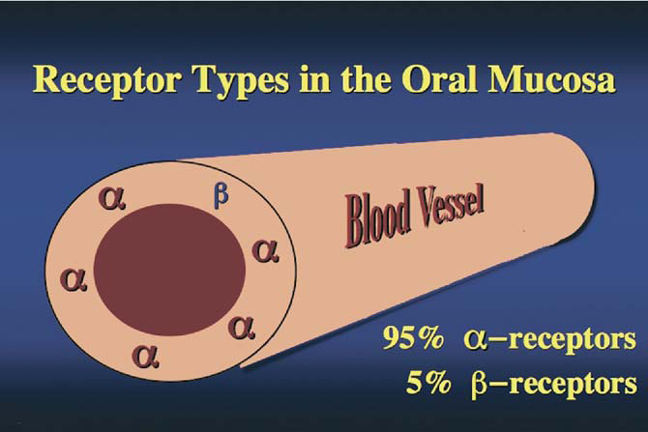
Ideally, for the purpose of endodontic microsurgery, an adrenergic vasoconstrictor would be a pure –alpha agonist.
Fortunately, the predominant receptors in the oral tissues are alpha-receptors, and the number of collocated ß-2 receptors is very small.
Thus, the drug’s predominant effect in the oral mucosa, submucosa and periodontium is vasoconstriction.

Slide 10
Surgical Access
The goals of periradicular surgery are to access the affected area, remove the diseased tissue, evaluate the root circumference and root canal system, and place a biocompatible seal in the form of a root-end filling that can stimulate regeneration of the periodontium. The formation of new cementum on the surgically exposed root surface and on the root-end filling material is essential to regeneration of the periodontium.
Several general principles are important for designing the access to a diseased region:
1. The surgeon must have a thorough knowledge of the anatomic structures in relation to each other, including tooth anatomy.
2. The surgeon must be able to visualize the 3D nature of the structures in the soft and hard tissue (this reduces unnecessary tissue damage).
3. The trauma of the surgical procedure itself must be minimized, which includes the preservation of tooth and supporting structures.
4. The tissue and instruments must be manipulated within a limited space, with the aim of removing diseased tissues and retaining healthy tissues.
Cohen 10ed

Slide 11
Soft-Tissue Access
In designing the soft-tissue access window to the diseased tissue, the surgeon must take into consideration various anatomic features, such as frenum-muscle attachments, the width of attached gingiva, papillary height and width, bone eminence, and crown margins.
The supraperiosteal blood vessels of the attached gingiva extend from the alveolar mucosa and run parallel to the long axis of the teeth, lying in the reticular layer superficial to the periosteum.
A vertical (rather than an angled) releasing incision severs fewer vessels, reducing the possibility of hemorrhage. Also, the blood supply to the tissue coronal to the incision is not compromised, which prevents localized ischemia and sloughing of these tissues. Ultimately, the result is less bleeding during the procedure and enhanced healing.

Slide 12
Vertical Incision
The general principles for placement of a vertical relieving incision are:
1. The incision should be made parallel to the supraperiosteal vessels in the attached gingiva and submucosa
2. No cuts should be made across frenum and muscle attachments.
3. Frenum and muscle attachments should not be located in the reflected tissue if possible.
4. The incision should be placed directly over healthy bone.
5. The incision should not be placed superior to a bony eminence.
6. The dental papilla should be included or excluded but not dissected.
7. The incision should extend from the depth of the vestibular sulcus to the midpoint between the dental papilla and the horizontal aspect of the buccal gingival sulcus.

Slide 13
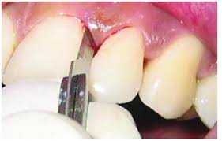
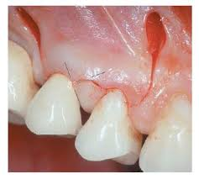
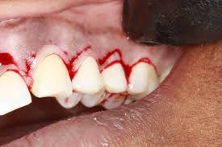
Horizontal Incision
Three types of horizontal incisions
♦ An intrasulcular incision that includes the dental papilla. This incision extends from the gingival sulcus through the PDL fibers and terminates at the crestal bone of the alveolar bone proper. The incision then passes in a buccolingual direction adjacent to each tooth of the dental papilla and includes the midcol region of each dental papilla. The entire dental papilla is completely mobilized.
♦ An intrasulcular incision that excludes the dental papilla (papillary-based incision). This technique consists of a shallow first incision at the base of the papilla and a second incision directed to the crestal bone.
An incision made in the attached gingiva (a submarginal or Ochsenbein-Luebke flap). With this technique, at least 2 mm of attached gingiva must be retained to prevent mucogingival degeneration.
Consequently, the incision must be placed at least 2 mm from the depth of the gingival sulcus. Overall, this incision technique has a narrow margin of safety. It generally is recommended for use in the maxilla, especially where the esthetics of existing crown margins are a concern.
Disadvantage: Sharp corners may slough in this case and during suturing cleft may occur if incision is made too close to free margina gingiva

Slide 14
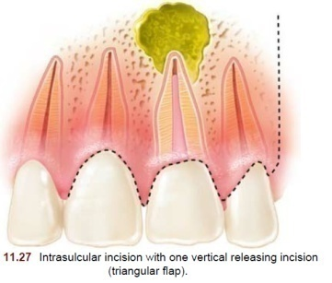
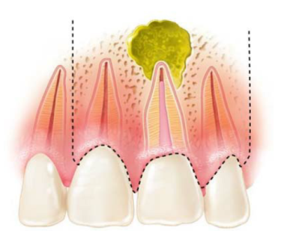
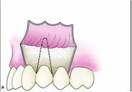
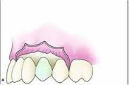
Flap Design
FULL MUCOPERIOSTEAL (INTRASULCULAR INCISION INCLUDING THE DENTAL PAPILLA OR PAPILLARY BASED)
Triangular: one vertical relieving incision
Rectangular: two vertical relieving incisions
Trapezoidal: two angled vertical relieving incisions
Horizontal: no vertical relieving incision

Slide 15
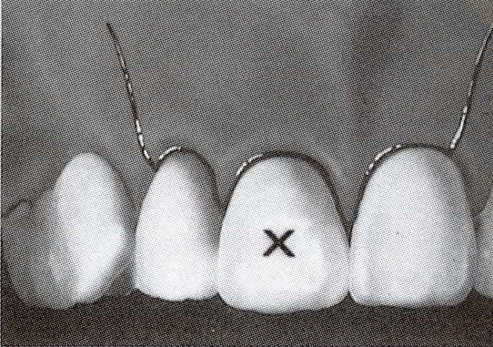
Since the blood vessels and collagen fibers in the mucoperiosteal tissues are oriented in a vertical direction, the base of the flap should be as wide as the top so that the incision follows the direction of the tissue fibers and blood vessels.
The angled vertical releasing incision will severe more of these vital structures,more bleeding, a disruption of the vascular supply to the unflapped tissues, delayed healing, scarring and shrinkage of the flapped tissues. The trapezoidal flap is contraindicated in periradicular surgery.

Slide 16
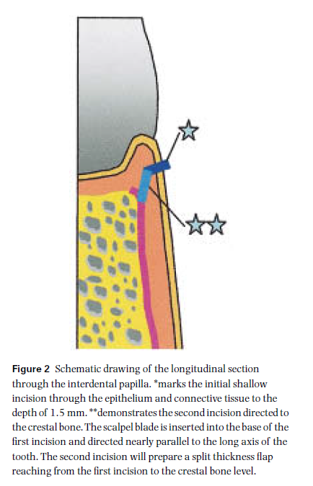

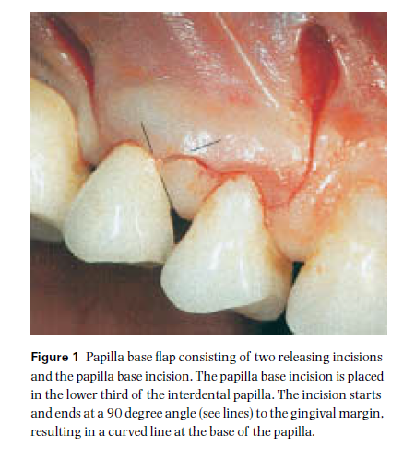
The papilla-base flap
The papilla-base flap could be best termed a hybrid variation of a full sulcular and split-thickness incisions, and has been suggested to prevent the gingival recession seen with the aforementioned 2 flap designs.
This flap consists of 2 vertical releasing incisions, connected by intrasulcular incisions in the cervical areas of the planned reflection concomitant with the papilla-based split-thickness variation.
The split-thickness incision is accomplished in 2 steps:
the first is a shallow cut, meant to sever the epithelium and connective tissue to a depth of 1.5 mm from the surface of the gingiva, subscribing a curved line, perpendicular to the gingival margin, and connecting one side of the papilla to the other.
The second cut is more vertical in nature, tracing the original incision but deep enough to contact the alveolar bone margin . This cut will produce a split-thickness flap at the apical third of the base of the papilla. This split-thickness incision is joined by the intrasulcular cut(s) at the cervical margin, completing the release of the marginal gingival complex. The intended flap is then reflected as a full-thickness mucoperiosteal event, apically positioned as dictated by the intended operative site.
The one crucial caveat is the choice of scalpel blade; it should not exceed 2.5 mm in width, to allow for the delicate course of the incision and minimize inadvertent overcutting of the tissue
Although very predictable in terms of minimizing soft tissue recession, this is a very challenging flap design to execute and, if the tissues are mishandled, primary coaptation of the epithelial margins will be compromised; necrosis of the affected sections will occur and lead to formation of a surgical scar
Also incumbent in this flap design is the size of the sutures used in closure; 7-0 to 8-0 polypropylene monofilament, at least 2 placed per papilla.
Velvart P. Papilla base incision: a new approach to recession‐free healing of the interdental papilla after endodontic surgery. International Endodontic Journal. 2002 May;35(5):453-60.

Slide 17
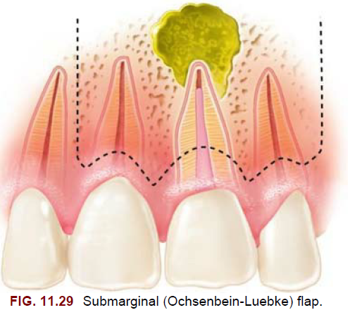

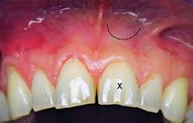
LIMITED MUCOPERIOSTEAL
a. Curve submarginal (semilunar)
Adv: 1.close proximity to apex
2.esthetic
Disadv: 1. improper surgical access
2.Scar formation
Semilunar incision was the most commonly used incision design in older surgical procedures, especially in the maxillary anterior area.
This incision is no longer used, as it does not allow for an adequate access to the surgical site and is related to prolonged inflammation and scar formation on healing of the wound
b. Freeform rectilinear submarginal (Ochsenbein-Luebke)
Adv.
It does not involve the marginal or interdental gingiva and does not expose any crown margins
As the crestal bone is not exposed, the risk of attachment loss is minimized.
Disadv.
1.Vertically oriented blood vessels and collagen fibers are severed, resulting in more bleeding and a greater potential for flap shrinkage, delayed healing and scar formation.
2. Careful evaluation of any buccal or labial periodontal pockets must also be made to minimize the possibility of leaving unflapped gingival tissue without bony support.
3. this design is contraindicated in cases where a large apical lesion is present or there is an inadequate band of attached gingiva.(minimum 2mm required)

Slide 18
Modern microsurgery is using the triangular flap with 1 vertical incision, the papilla base incision for preservation of the papillae and the Luebke-Ochsenbein submarginal flap.
The last one is the most commonly used esthetic flap design especially in the maxillary anterior area. It is performed within the zone of the attached gingiva and results in almost zero recession of the gum margins
and the interdental papillae postoperatively
Therefore, crown margin exposure and formation of “black triangles” in anterior teeth as well as food impaction in posterior teeth is prevented.
vertical incisions should be 1.5 to 2 times longer than in the traditional technique, so the flap is reflected far away from the light path of the microscope and adequate visibility of the surgical site is achieved.

Slide 19
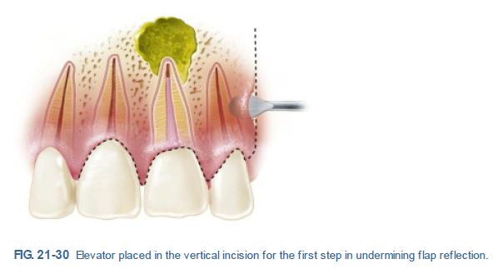
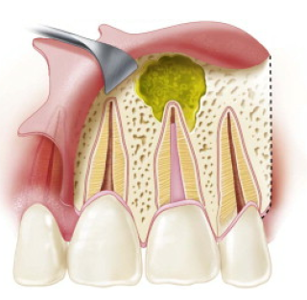
Tissue Reflection
Tissue reflection should begin from the vertical releasing incision at the junction of the submucosa and the attached gingiva .
Force should be applied such that the periosteum and superficial tissues are reflected as a complete unit. Using a gentle rocking motion, the surgeon initially should reflect the tissue in a horizontal direction.
The underlying bone of the cortical plate is irregular, and it is critical to avoid damaging the fragile tissues during elevation.
The clinician should take great care not to slip during the tissue reflection process; this can be done by using an appropriate instrument stabilized with adequate finger support. Slipping can result not only in puncture of the immediate overlying tissue but also damage to the surrounding structures

Slide 20
As space permits, the elevator should be directed coronally, undermining the attached gingiva.
As the papilla is approached, a narrower instrument may be required to undermine and gently elevate the tissue in this region to avoid crushing the delicate free gingival tissues. This process should be continued gradually until the osseous tissues overlying the diseased tooth structure have been adequately exposed.
Generally, elevation of the flap 0.75 cm apical to the estimated apex of the root should allow adequate space to perform the surgical procedure

Slide 21
Tissue Retraction
The general principles of retraction are
(1) retractors should rest on solid cortical bone;
(2) firm but light pressure should be used;
(3) tearing, puncturing, and crushing of the soft tissue should be avoided;
(4) sterile physiologic saline should be used periodically to maintain hydration of the reflected tissue; and
(5) the retractor should be large enough to protect the retracted soft tissue during surgical treatment (e.g., prevent it from becoming entangled in the bone bur).
If difficulty is encountered in stabilizing the retractor, a small groove can be cut into the cortical plate to support it.

Slide 22
Hard-Tissue Access
Two biologic principles govern the removal of bone for hard-tissue access to diseased root ends:
healthy hard tissue must be preserved, and
heat generation during the process must be minimized
Temperature increases above normal body temperature in osseous tissues are detrimental. Heating osseous tissue to 117° F to 122° F (47° C to 50° C) for 1 minute significantly reduces bone formation and is associated with irreversible cellular damage and fatty cell infiltration
Two critical factors determine the degree of injury:
how high the temperature is increased and
how long it remains elevated.

Slide 23
As the temperature rises above 104° F (40° C), blood flow initially increases. It stagnates at 198° F (46° C) applied for 2 minutes. Heating osseous tissue to 133° F (56° C) deactivates alkaline phosphatase.
A high-speed handpiece that exhausts air from the base rather than the cutting end is recommended to reduce the risk of air embolism(Impact air)
Several factors determine the amount of heat generated during bone removal, including the shape and composition of the bur, the rotational speed, the use of coolant, and the pressure applied during cutting.
The round bur has the best shape for removing osseous tissue, and it should be used with a gentle brushstroke Action. This type of bur also readily allows access of coolant to the actual cutting surfaces

Slide 24

The triad of endodontic microsurgery
MAGNIFICATION AND ILLUMINATION
The surgical operation microscope provides illumination and magnification and it has fundamentally changed the way endodontic surgery is performed.
INSTRUMENTATION
Working in a magnified surgical site requires a different set of surgical instruments.
Ultrasonic tips, condensers, pluggers, curettes, and mirrors were reduced in size to comfortably fit into an osteotomy no larger than 5 mm to gain access to the canals.
With bright, focused light on an x4 to x31 magnified surgical site, the surgeon can see every detail of the apical structures and can execute treatment more precisely.

Slide 25
Modern Endodontic Surgery Concepts and Practice JOE — Volume 32, Number 7, July 2006

Slide 26
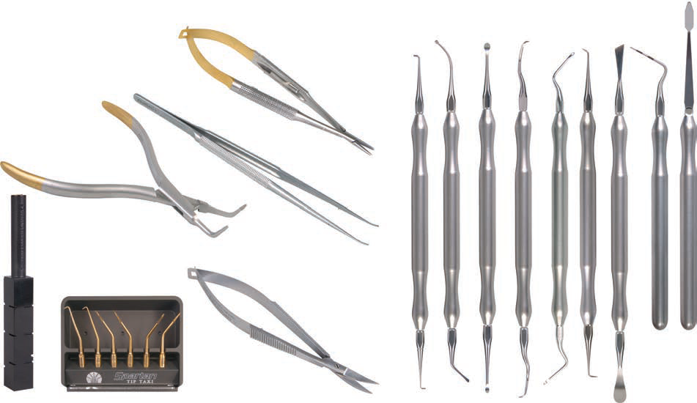
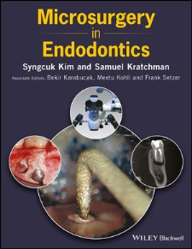
Microsurgical Instruments
Examination Instruments
Incision and Elevation Instrument
Tissue Retraction Instruments
Osteotomy Instruments
Curettage Instruments
Inspection Instruments
Ultrasonic Units and Tips for Root End Preparation
Retro filling Instruments
Suturing Instruments

Slide 27
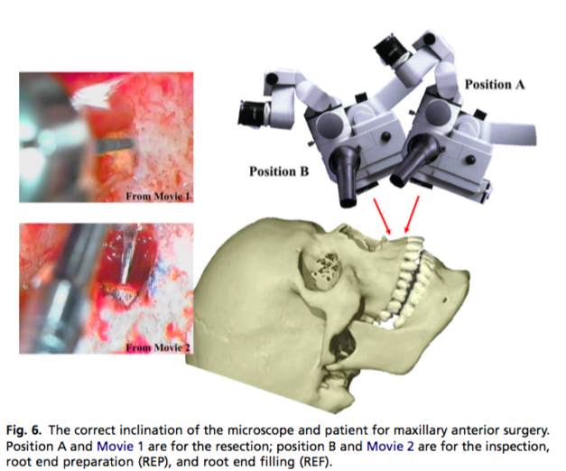
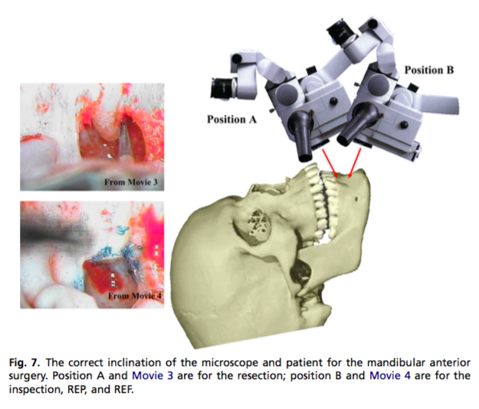
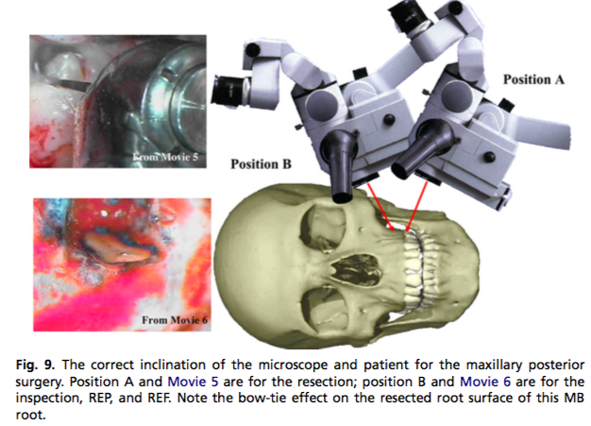
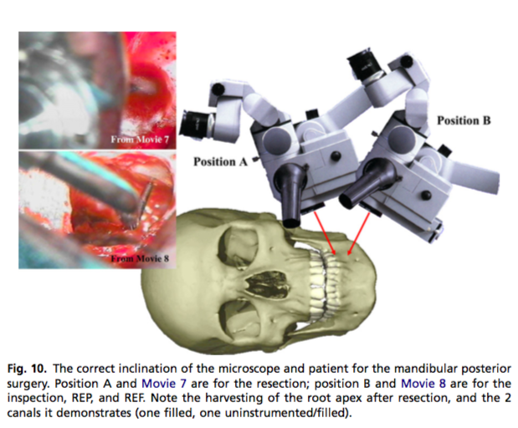
Niemczyk et al; Essentials of Endodontic Microsurgery; Dent Clin N Am 54 (2010) 375–399

Slide 28
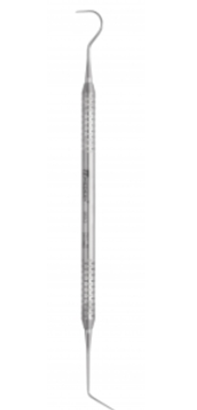
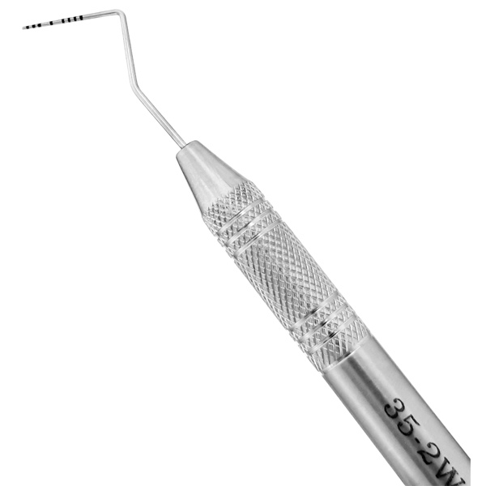
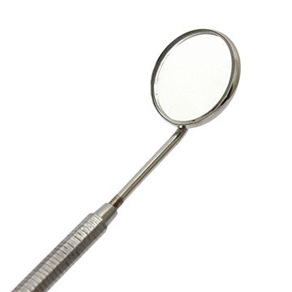
Examination Instruments
Includes the mirror, periodontal probe, explorer and micro explorer

Slide 29
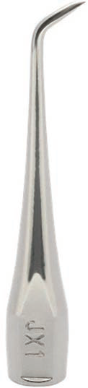
Microexplorer
2-mm tip bent at 90 degrees on one end and 130 degrees on the other.
The short tip makes it particularly easy to maneuver inside the small boney crypt.
Useful for locating an area of leakage on the resected root surface and for distinguishing a fracture line or canal from an insignificant craze line.

Slide 30
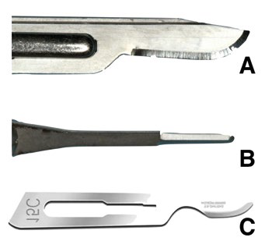
Incision and Elevation Instrument
15C blade
The ideal scalpel blade for microsurgery
Small enough to manage the interproximal papilla and large enough to make a vertical releasing incision in one stroke
Microblades
Useful only when the interproximal spaces are tight.
a size 15;
a microsurgical blade;
a 15c blade
Notes:
Flatter and thinner than the traditional #15 blade, with a longer and more extended cutting edge, rounded belly, and a more acute taper.

Slide 31
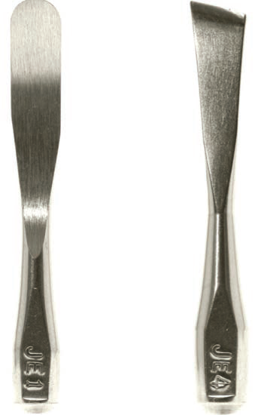
Tissue elevators
To elevate the gingiva and tissue from the underlying cortical bone with minimal trauma to the tissue.
One end of the instrument has a thin, sharp, triangular beak and the other end has a sharp, rounded beak that varies in size.
This new design incorporates thin edges and points that allow the soft tissue to be elevated from the bone cleanly and completely.

Slide 32
TAKE HOME MESSEGE/ FOR THE TOPIC COVERED (SUMMARY)
The principle treatment modalities for the management of post-treatment periapical pathosis are orthograde retreatment and apical surgery.
A significant advantage to surgical intervention is that it offers immediate access to the root apex.
Furthermore, it includes curettage of the periradicular granulomatous tissues and the resection of the apical 3 mm of the root, which frequently contains infected canal ramifications

Slide 33
Question & Answer Session
1. Write a short note on types of incision .
2. Write in brief about triad of endodontic microsurgery.
3. Short note on papilla based flap .

Slide 34
REFERENCES NAME OF THE BOOK WITH EDITION AND PAGE NUMBERS ARTICLE ARE TO BE MENTIONED IF NEEDED
Ingle JI, Bakland LK. Endodontics. 4th ed. Philadelphia:Williams and Wilkins; 1995.
Grossman LI, Oliet S, Del Rio C. Endodontics. 11th ed. Philadelphia: Lea and Febiger; 1988
Rowe AHR. Damage to the inferior dental nerve during or following endodontic treatment. Br Dent J 1983;153:306
Seltzer S, Bender IB, Turkenkopf S. Factors affecting successful repair after root canal therapy. J Am Dent Assoc 1963;67:651
Walia H, et al. Use of a hemostatic agent in the repair of procedural errors. JOE 1988;14:465.

Slide 35


